Slide 1


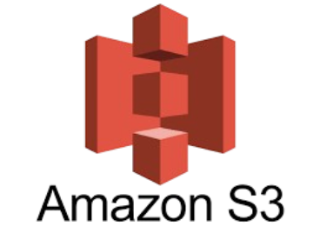
S3 STATIC WEB HOSTING WITH CLOUDFRONT
Presented by Aman Dandale

Slide 2

INTRODUCTION
What is Amazon S3?
Amazon S3 is an object storage service that offers industry-leading scalability, data availability, security, and performance.
Store and protect any amount of data for a range of use cases, such as data lakes, websites, cloud-native applications, backups, archive, machine learning, and analytics.
Amazon S3 is designed for 99.999999999% (11 9's) of durability, and stores data for millions of customers all around the world.
What is static web hosting?
Static website hosting in Amazon S3 is a way to store and host a website without the need to maintain servers.
It is a type of web hosting that delivers fixed web pages directly to the user's browser.

Slide 3
OBJECTIVE
S3 static web hosting is a cost-effective and scalable solution to deploy static websites directly on Amazon S3. It eliminates the need for traditional web servers. Key objectives include:
Reduced Costs: Lower storage and data transfer costs.
Enhanced Scalability: Easily handles increased traffic without performance degradation.
High Availability and Durability: Ensures website accessibility and data integrity.
Global Reach: Delivers content to users worldwide with low latency.
Simplified Deployment: Streamlined setup process.
Integration with AWS Services: Seamlessly integrates with other AWS services for added functionality.

Slide 4
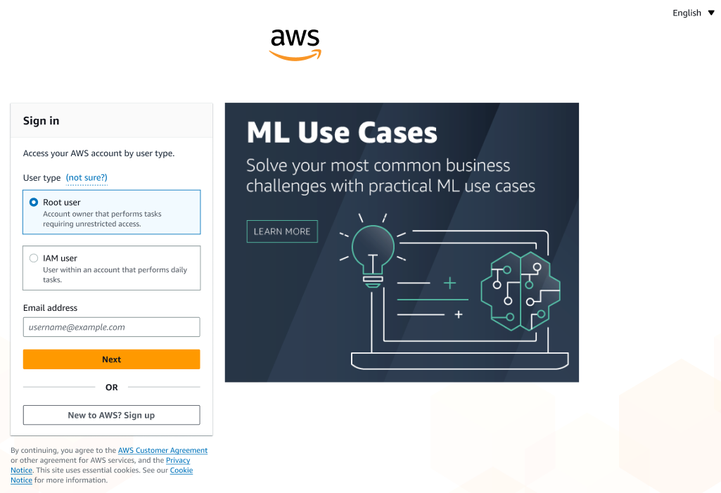
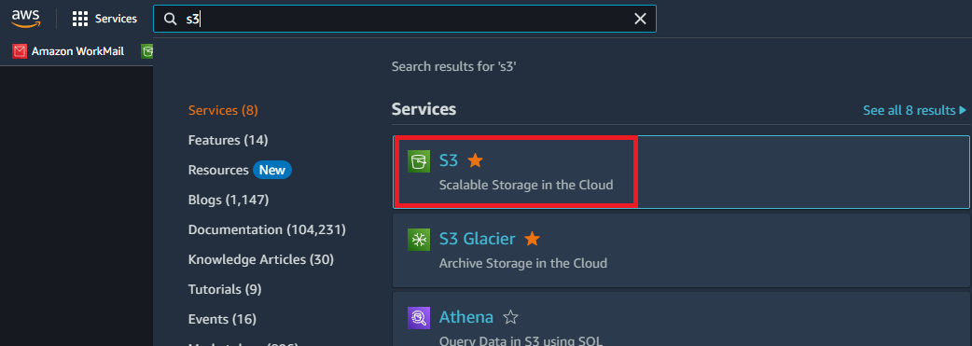

Step 1: Sign In to AWS Console
Open your web browser and navigate to the AWS Management Console.
Enter your AWS account credentials (username and password) to log in.
Search for S3 on AWS console

Slide 5
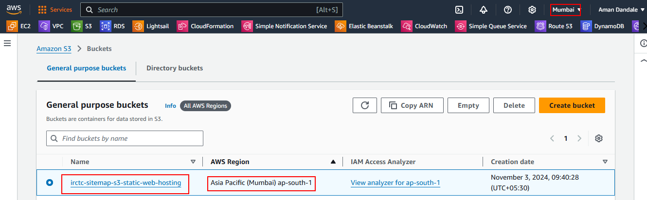
Step 2: Create S3 Bucket
Choose Create bucket.
Enter the globally unique name for Bucket (irctc-sitemap-s3-static-web-hosting).
Choose the Region where you want to create the bucket.
Choose a Region that is geographically close to you to minimize latency and costs, or to address regulatory requirements.
The Region that you choose determines your Amazon S3 website endpoint.

Slide 6
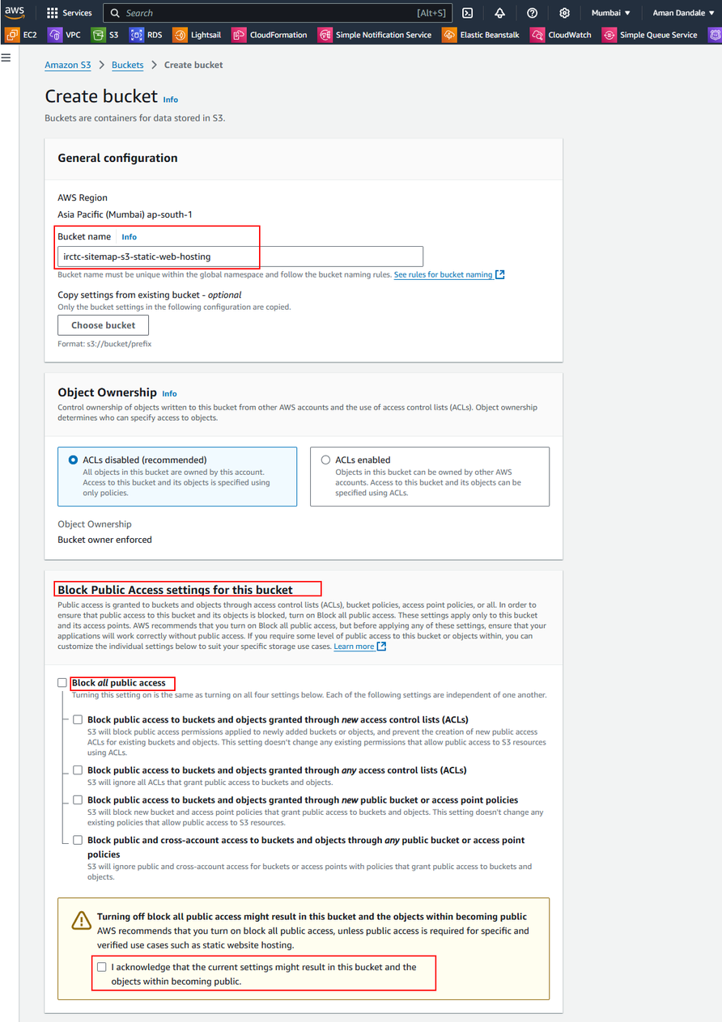
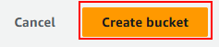
Step 3: Edit Block Public Access settings
By default, Amazon S3 blocks public access to your account and buckets. Clear Block all public access.
Amazon S3 turns off the Block Public Access settings for your bucket. To create a public static website
Enable Bucket Versioning (Versioning is a means of keeping multiple variants of an object in the same bucket.)
Leave the default settings for the rest of the options and click “Create bucket.

Slide 7
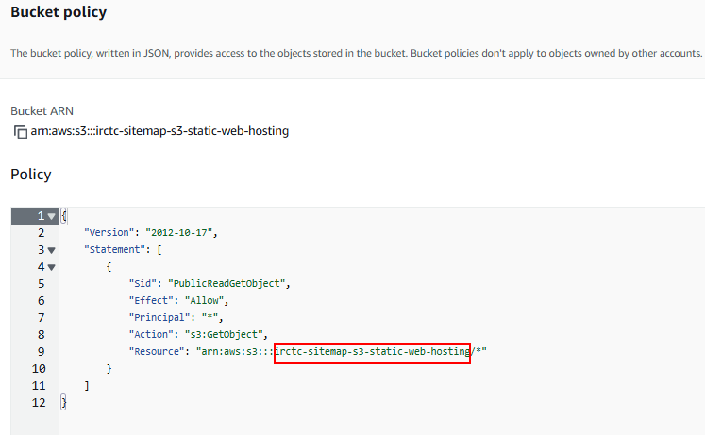

Step 4: Add a bucket policy that makes your bucket content publicly available
Once the bucket has been created, select it from the list of buckets.
Go to the “Permission” tab and Under Bucket Policy, choose Edit.
To grant public read access for your website, copy the following bucket policy, and paste it in the Bucket policy editor and save changes
Bucket policy for public access

Slide 8
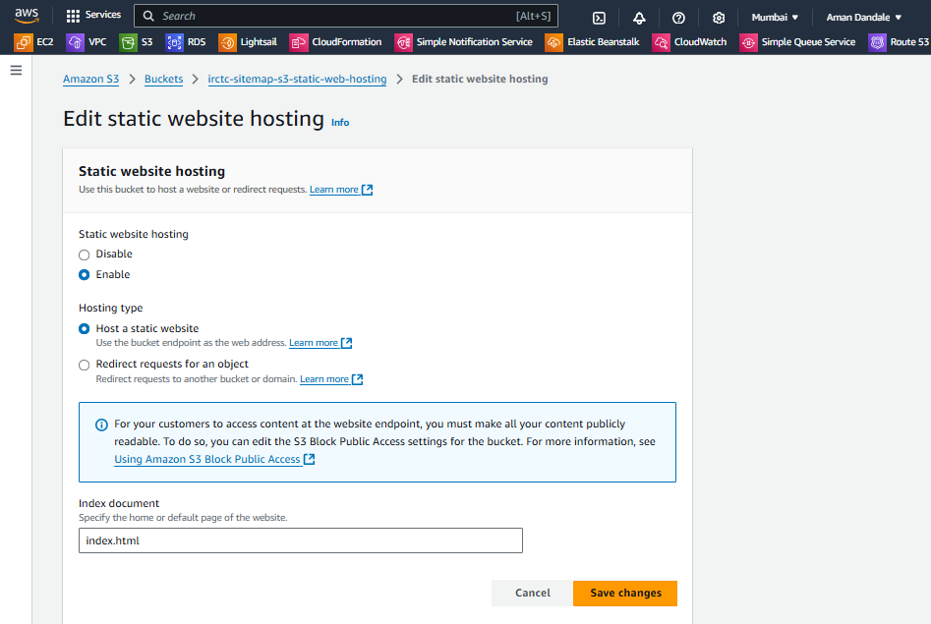
Step 5: Enable static website hosting
After we create a bucket, we can enable static website hosting for our bucket.
Choose Properties.
Under Static website hosting, choose Edit.
Choose Use this bucket to host a website.
Provide Index Document as index.html
Under Static website hosting, choose Enable.
After this, save the changes.

Slide 9
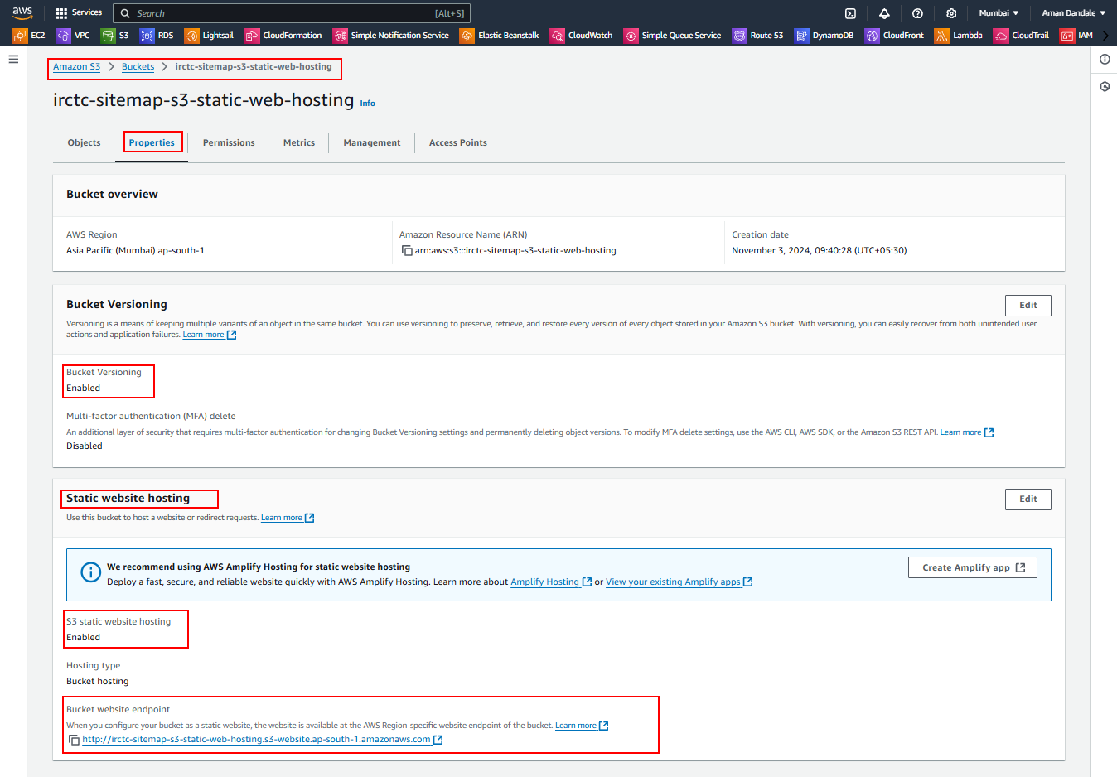

Slide 10
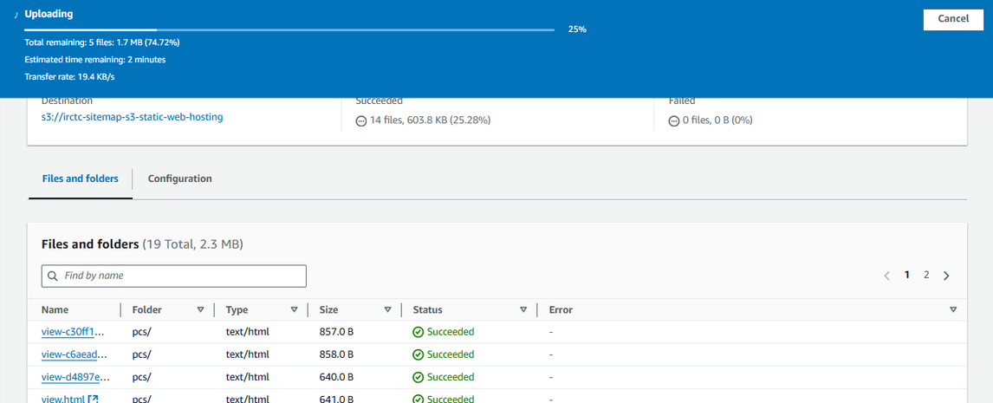
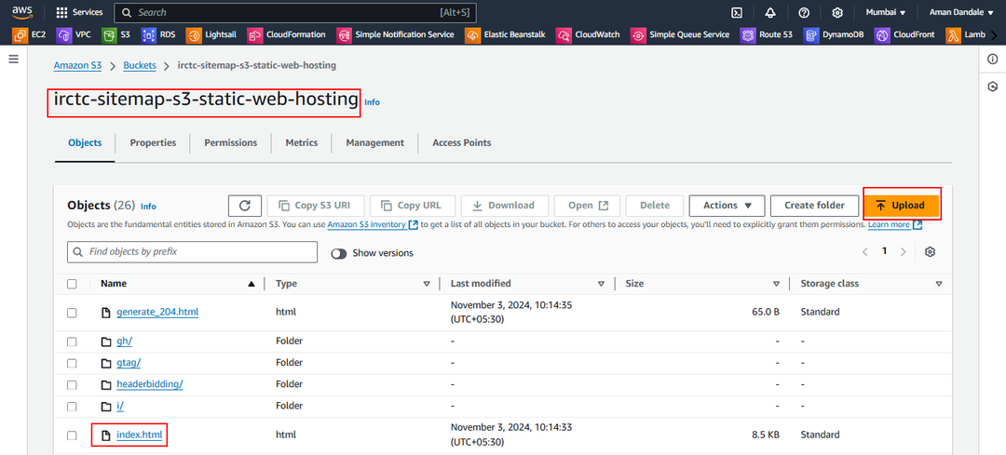
Step 6: Configure an index document and upload website Files
When we enable static website hosting for our bucket, We have to enter the name of the index document (for example, index.html).
After we enable static website hosting for the bucket, we will upload an HTML file with this index document name to our bucket.
To upload the index document to our bucket, do one of the following:
1.Drag and drop the index file into the console bucket listing.
2.Choose Upload, and follow the prompts to choose and upload the index file.
In our case upload present IRCTC website sitemap content to our bucket.

Slide 11
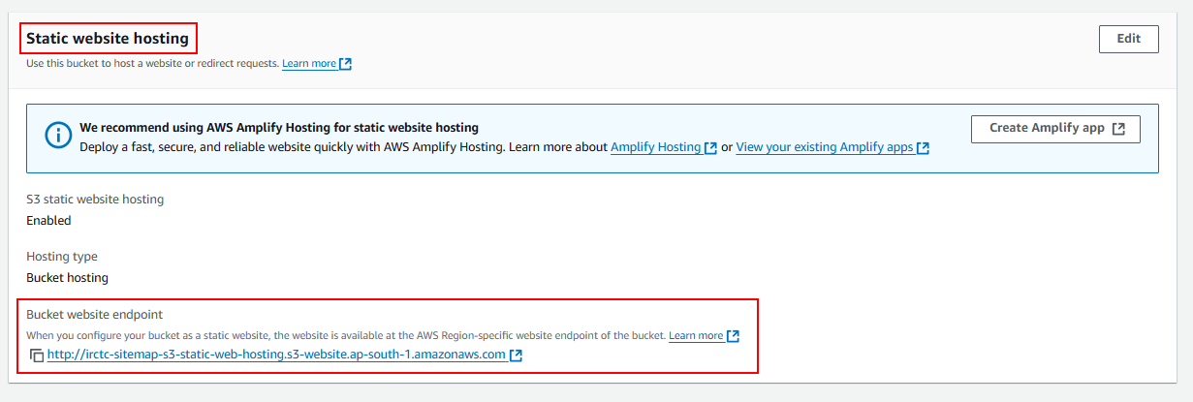
Step 7: Test the website endpoint
Under Buckets, choose the name of your bucket.
Choose Properties.
At the bottom of the page, under Static website hosting, choose your Bucket website endpoint.
Your index document opens in a separate browser window.
After making bucket public, Our static website should be accessible at the endpoint provided in the “Static website hosting” section of our bucket’s properties.
It will look like this: http://irctc-sitemap-s3-static-web-hosting.s3-website.ap-south-1.amazonaws.com

Slide 12
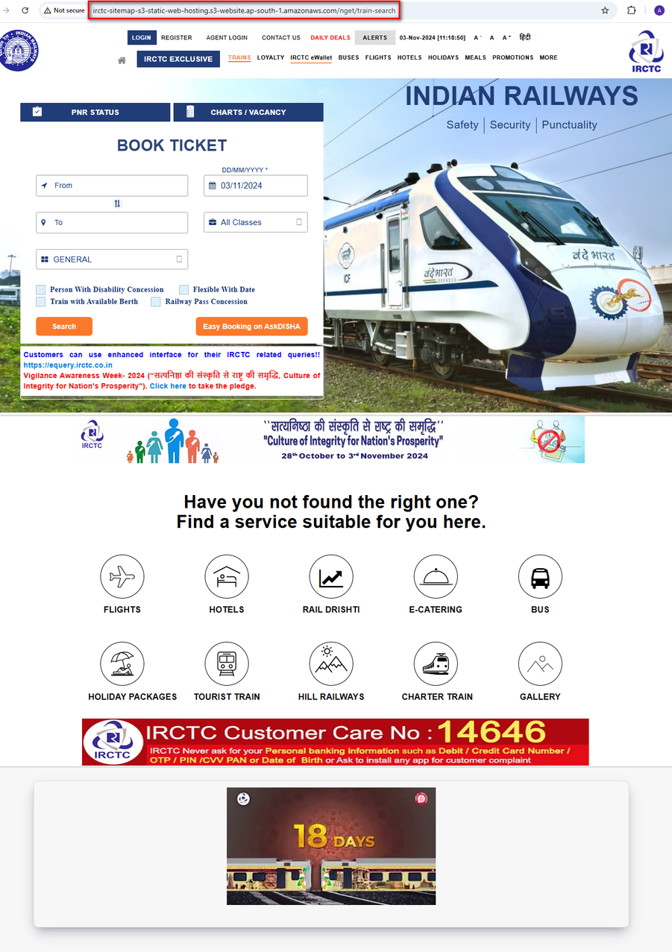
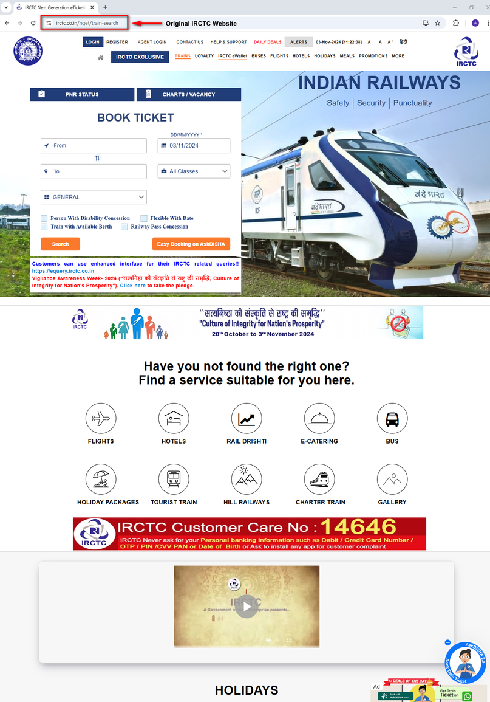
Step 8: Access the S3 endpoint for the sitemap and original IRCTC website

Slide 13
LIMITATIONS
Limited Server-Side Processing: Not suitable for complex dynamic applications.
Security: Requires careful configuration to prevent unauthorized access.
Performance Optimization: May require additional configuration for optimal performance.
Custom Error Pages: Limited customization options compared to traditional web servers.
Scalability for Dynamic Content: Less flexible for scaling dynamic content compared to traditional web servers.

Slide 14
CONCLUSION
S3 static web hosting is a powerful and cost-effective solution for deploying static websites.
It leverages the scalability, durability, and global reach of AWS S3 to deliver high-performance websites.
While it's ideal for static content, it's important to understand its limitations, especially when dealing with complex dynamic applications. By carefully considering your website's requirements and leveraging S3's capabilities,
You can create robust and scalable web solutions.

Slide 15
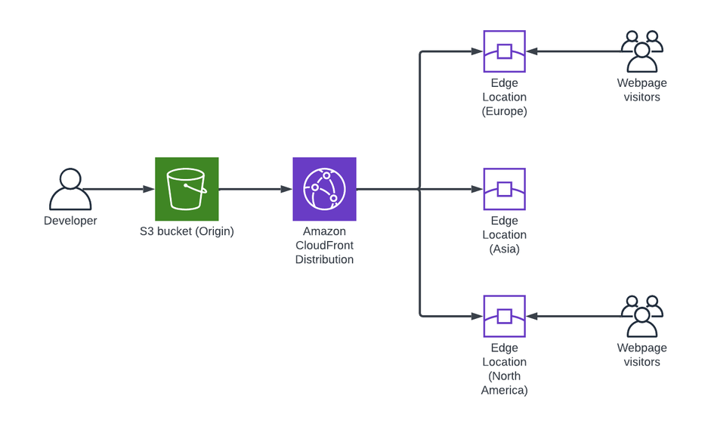
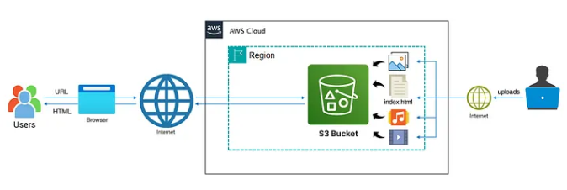
ARCHITECTURE

Slide 16
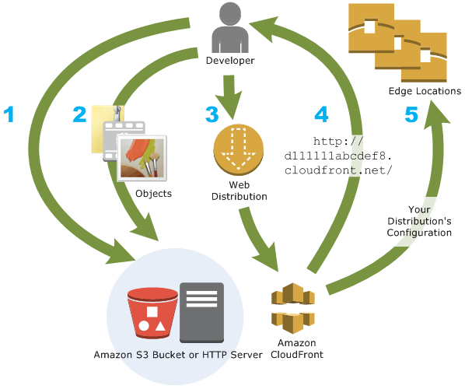
CLOUDFRONT (CDN)
What is ClouFront?
Amazon CloudFront is a web service that speeds up distribution of your static and dynamic web content, such as . html, .css, . js, and image files, to your users.
It leverages AWS's global cloud infrastructure with a large number of edge locations worldwide.
Offers consistent performance across regions due to its integration with AWS's network.

Slide 17
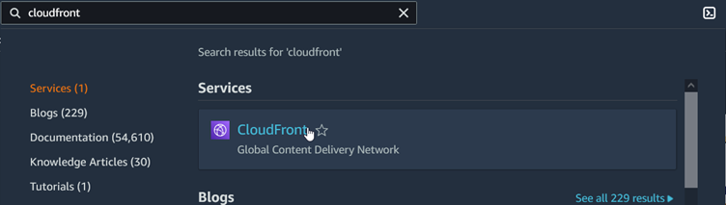
Step 9: Create a CloudFront distribution
First, we need to create a CloudFront distribution. This makes our website available from data centers around the world.
Search for Cloudfront on AWS console
In the navigation pane, choose Distributions, then choose Create distribution.
Specify settings for the distribution.
Origin domain : Choose an AWS origin, or enter your origin's domain name (irctc-sitemap-s3-static-web-hosting.s3.ap-south-1.amazonaws.com)
Origin access : Public (Bucket must allow public access.)
Leave the default settings for the rest of the options and click “Create Distribution.

Slide 18
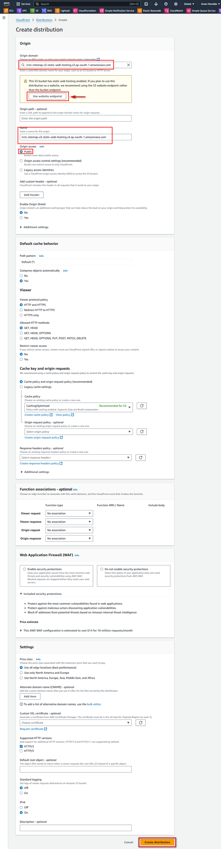
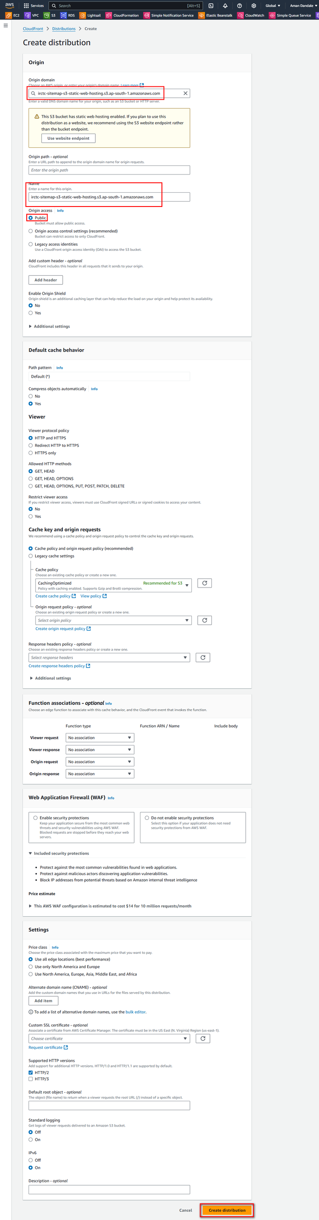
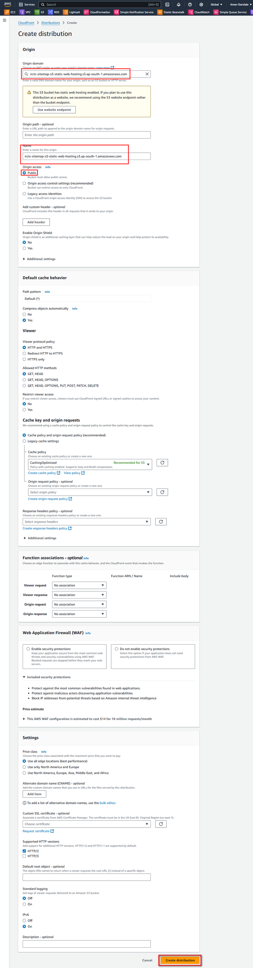
Step 9: Create a CloudFront distribution

Slide 19
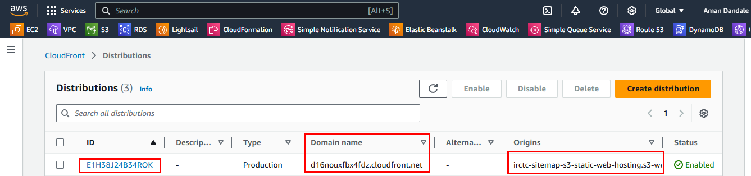
Step 10: Access the CloudFront Domain Name
Once the cloudfront distribution has been created. It will generate publicly accessible domain name for us.
We can access our website or S3 bucket content with this domain publicly.
Domain will look like after SSL/TLS: https://d16nouxfbx4fdz.cloudfront.net

Slide 20
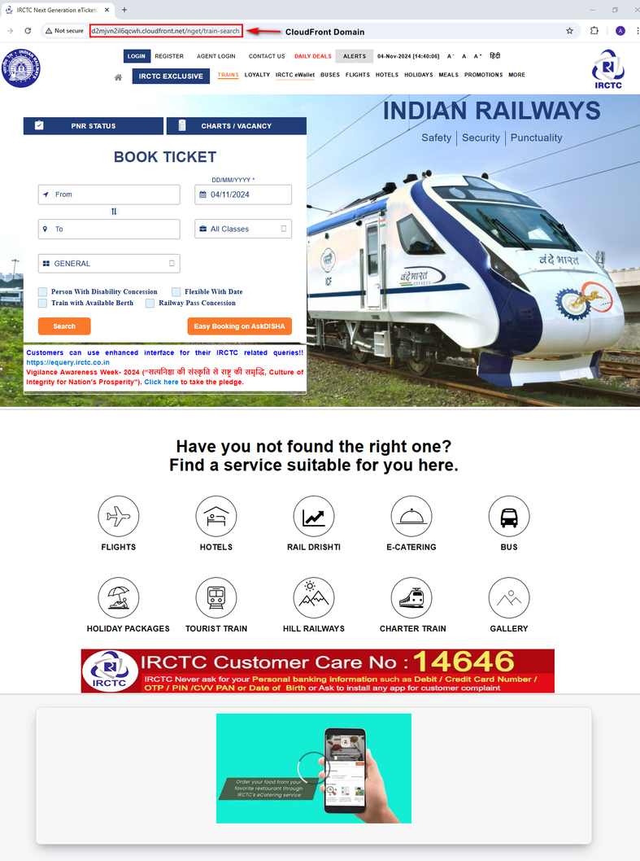
Step 10: Access the S3 endpoint for the sitemap, CloudFront Domain and original IRCTC website

Slide 21
ADVANTAGES OF CLOUDFRONT
Amazon CloudFront is a Content Delivery Network (CDN) that offers:
Faster content delivery: By caching content closer to users, reducing latency.
Enhanced security: Protects content with features like DDoS protection and SSL/TLS encryption.
Scalability: Automatically adjusts to handle increased traffic.
Cost-effective: Pay-as-you-go pricing and optimized cost structure.
Ease of use: User-friendly interface and seamless integration with other AWS services.

Slide 22
REFERENCE
Documentation of Configuring a static website on Amazon S3
IRCTC sitemap files
Tutorial Video

Slide 23
Thank You
For your attention

